Slide 1



Slide 2
" In The Name of Allah, The Most Beneficent, The Most Merciful"
Potential opportunities in the Halal market
By: Dr. Hani M. Al-Mazeedi
Note: An ample part of this presentation was extracted from: Potential & Opportunities in Halal Industry - An Overview by Asad Sajjad, CEO of Gulf Halal Center Prepared for World Halal Assembly OMAN, 2017, Organized by Al-Nimr Expo & HDCMICE middle east, May 16th - 17, 2017

Slide 3
Scope
This presentation shed the light on the current status of global Halal market and its potential investment opportunities in its products and services.
A market with a fortune of revenue.
A market with about two billion Muslim consumers and more than this number with non-Muslims.
A market with economically growing with estimated annual rate of 20%. Thus making it one of the fastest growing consumer segments in the world, and creating a strong presence in developed countries.
*STATE OF THE GLOBAL ISLAMIC ECONOMY REPORT 2016/17
https://www.salaamgateway.com/en/story/ReportStateoftheGlobalIslamicEconomy201718-SALAAM27112017104745/

Slide 4
The global halal market has emerged as a new growth sector in the global economy.
Muslim consumers’ tastes and preferences are governed by halal rules on food and non-food specification.
Awareness about the concept of Halal is on the rise, and international companies are responding to consumer needs, be it for products or services.
Zakaria, Z. (2008). "Tapping into the world halal market: some discussions on Malaysian laws and standards." Shariah Journal 16(3): 603-616.

Slide 5
In this presentation, the latest developments and trends from this economy will be highlighted in addition to the specific opportunities for investor to engage with the Halal sector.

Slide 6
Content
Scope
Introduction
Market Potential & Opportunities
Proposed Collaboration
Summary
Conclusions
Recomindation

Slide 7
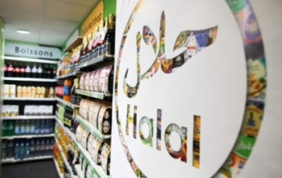
Introduction
An analysis on the Halal industry by Dubai chamber of commerce showed that the size on the demand for Halal food and non-food products is witnessing a remarkable rise in all parts of the world.
*Dubai chamber of commerce (2013). http://www.dubaichamber.com/whats-happening/chamber_news/dubai-chamber-report-shows-increasing-preference-for-halal-food-as-global-market-grows-to-us1-1-trillion-in-2013

Slide 8
Which refers to the increase in the awareness in all over the world on the principles of sustainable health¹ and asserting Islamic religious values² from the production of halal food & beverages¹ and non-food products² like Halal Pharmaceuticals, Cosmetics and Health care products

Slide 9
Many food economists posit طرح that the halal food industry will become a major market force in the near future based on four prevalent trends:
Firstly, Islam is now the fastest growing religion in the world thus fuelling a global demand for halal products. The annual growth in consumption of halal food is estimated at 16%.
Halal Industry : Key Challenges and Opportunities (2016), Hussein Elasrag, Munich Personal RePEc Archive.
https://mpra.ub.uni-muenchen.de/69631/1/MPRA_paper_69631.pdf

Slide 10
Secondly, the increasing trend of consuming halal food products for ethical¹ and safety² reasons by non-Muslim consumers.
In the UK, for example, there are over 2 million Muslims, yet there are 6 million consumers of halal meat!
In the Netherlands, non-Muslim Dutch consumers have shown marked interest in halal food where total demand is estimated to reach about USD3 billion on an annual basis.

Slide 11
These two factors combined have made halal products mainstream consumer goods.
Third, is the rising halal consumer power as a market force in tandem بالتزامن مع with the growth of the Muslim population and their rising disposable income.

Slide 12
Finally, there is greater awareness among Muslims on the need and necessity to consume only halal food.
A good example of such increasing consumer awareness is the rapid rise in annual sales of halal food throughout Russia with a growing demand for halal products between 30% and 40% annually.

Slide 13
Until a decade ago, halal food products were offered in traditional corner shops and neighborhood butchers.
The halal market has witnessed a universal shift in the demand and supply chains of halal food products. They are increasingly made available in Western-style grocery stores including supermarkets and hypermarket chains.

Slide 14
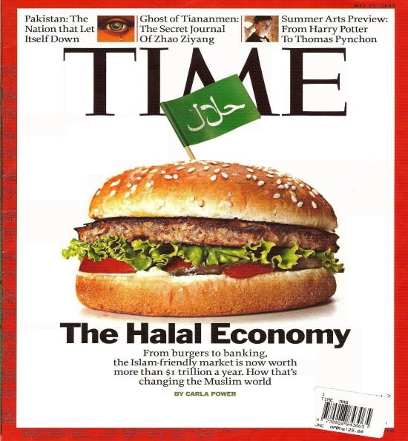
In many western countries, supermarkets and food producers are starting to reach out to Muslim consumers by offering a wider selection of halal food products.

Slide 15
Halal food is becoming an increasing part of the Western diet and has become a multi-billion dollar global industry involving multinationals like Tesco, Unilever and Nestlé who have aggressively expanded their halal-certified product lines.

Slide 16
To date, Nestle is the biggest food manufacturer in the halal sector with annual sales of more than USD5 billion. Halal food accounts for about 35% of Nestlé’s global sales.

Slide 17
The Halal industry continues to evolve, driven by young Muslims asserting their values, and requiring companies to provide products and services that meet their faith-based needs.

Slide 18
Theoretically, halal is possible to be the benchmark for quality with specifically refers to whatever is permitted by Islamic Shariah and applies to every activity carried out by mankind, and this makes it sound as the new green.

Slide 19
What does the Halal market cover?
The Halal market is part of the Halal industry that deals with a wide spectrum of Halal oriented activities in products¹ and services² covering all types of food¹ and non-food products².

Slide 20
Examples of Food products (Edibles)
Food Ingredients & Raw materials
All type of Packaged Food & Beverages
Agriculture products and Seafood
Special Food, Herbal food, Baby Food, Health Food
Flavors and Fragrances
Meat & Poultry Abattoirs / slaughter houses

Slide 21
Examples of Non-Food products
Pharmaceuticals, Cosmetics, and Personal Care
Body care, Toiletries, Perfumes.
Animal & Poultry Feed
Leather products, Apparel & accessories
Packaging & Processing material & equipment

Slide 22
Examples of services
Food Service (restaurants, café, fast food, & catering)
Halal Certification, Auditing and Consultancies
Halal Training, Workshops, and Conferences
Hospitality, Tourism, Hotels, Media, and Fashion
Medical Tourism, Health Care, Hospitals & Clinics
Banking & Finance & Takawful.
Logistics services (Transport, Storage)
Halal Trading Services

Slide 23
Market Potential & Opportunities
Who are the Biggest Suppliers & Exporters countries of Halal Certified Products ?
The 10 biggest exporters of Halal Products are Non-Muslim countries:
India, Brazil, Australia, USA, Argentina, New Zealand, France, Thailand, Philippines and Singapore
enjoy almost 85% share of Global Halal Market.
India biggest in Halal meat - Thailand biggest in Halal products
Malaysia and Indonesia are the 2 main Muslim
countries with almost 15% share in the Global Halal market.
Turkey & Pakistan have recently become active.

Slide 24
Who are the Biggest Consumers of Halal Products?
I.e. Global Halal Target Market
Asia : More than 1.1 Billion Consumers
Africa: Over 470 million Consumers
Europe: More then 50 million Consumers
America: Halal Consumers almost 10 million
Oceania: 0.6 million Consumers in NZ, Australia and Fiji

Slide 25
Who are the Biggest Consumers of Halal Food?
I.e. Some examples of the Halal Food market size:
Europe, over $66 billion. (with only France $17 billion)
America, spends over $13 billion on Halal food annually.
GCC’s food imports is $26 billion.
Egypt consumes approx. $88 billion
Pakistan consumption is almost $93 billion
Turkey consumes approx. $100 billion
Indonesia’s annual Halal Food consumption is $197 billion.
Other major consumers of Halal Food include Malaysia, Africa, and other Muslim countries.

Slide 26
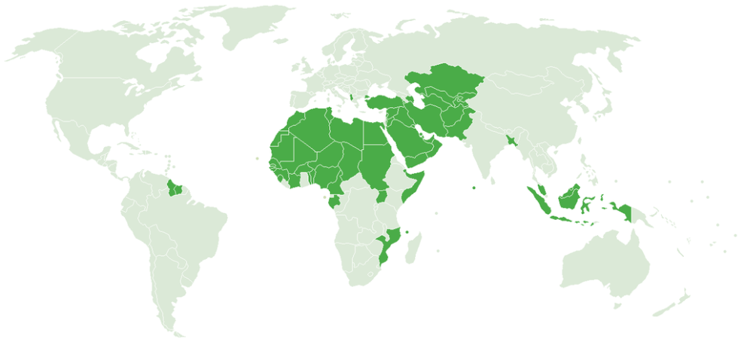


These figures confirm that the Islamic countries is still the first consumer of Halal products while Europe and American Markets are considered to be emerging markets, and it is expected that in the coming years Halal trade will accommodate a bigger size of the market if Islamic countries showed interests in producing Halal products and invade both European and American markets.

Slide 27
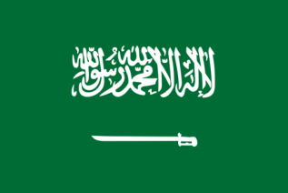
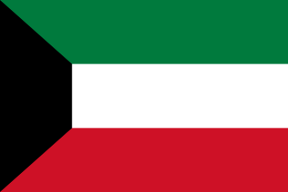
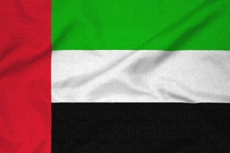

In light of the rapid growth of the economies of the Gulf region, such as Saudi Arabia, Kuwait and UAE, and the growing needs of the workforce, which will lead to an increase in population, it is expected that the volume of Halal food imports to these three countries will increase especially meat which constitute a main diet commodity of the population.
Oman on the other hand is booming in food production for the food security of Qatar.

Slide 28
One will find controversial figures on the size of the Halal market.

Slide 29
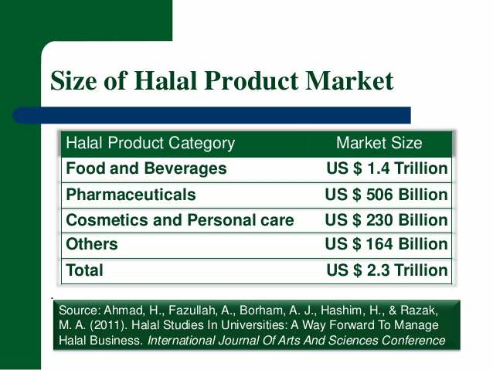

Slide 30
Global HALAL Market Present & Future
GLOBAL HALAL MARKET
The USD $ 3 Trillion Global Halal Market is divided in the following sectors:
SECTOR | Halal Market 2013 US $ (Billions)
Halal Food | $ 1,292
Islamic Finance | $ 1,214
Islamic Fashion | $ 266
Halal Tourism | $ 140
Media & Recreation | $ 185
Halal Pharmaceuticals | $ 72
Halal Cosmetics | $ 46
Potential Halal Market 2019, US $ (Billions)
$ 2,536
$ 4,178
$ 484
$ 238
$ 301
$ 103
$ 73
Source: State of the Global Islamic Economy 2014-2015/ by Thomas Reuters & DINAR Standard

Slide 31
Market Potential by Product Clusters
on only fours Halal sectors
Most of the Halal trade is in
Pharmaceuticals
Halal care Products
Halal food products (food and beverages)
Cosmetics
a
Does not include Islamic Financial Services. Services involved in final product e.g. certification, logistics, R&D are included in sectorial values
Based on sales revenue
Halal processed food is taken as 66% of the total based on world Halal meat consumption
Only non-alcoholic beverages
Source: Euro monitor reports; FAOSTAT
  62% Food and Beverages
  38% Others
Global market for Halal-potential products, 2005*
* Halal Industry : Key Challenges and Opportunities (2016), Hussein Elasrag, Munich Personal RePEc Archive.
https://mpra.ub.uni-muenchen.de/69631/1/MPRA_paper_69631.pdf

Slide 32
Each segment has evolved substantially, evidenced by new products, new players, and the maturing of existing players.

Slide 33

This mean that there are investment opportunities waiting to enter the Halal industry during the next years, which will generate revenues and jobs in various countries around the world*.
*The competitiveness of halal food industry in Malaysia: A SWOT - ICT analysis: GEOGRAFIA OnlineTM Malaysia Journal of Society and Space 9 issue 1 (1 - 9) 1 ©2013, ISSN 2180-2491
http://www.ukm.my/geografia/images/upload/1.geografia-jan%202013-manaf-edam%20%281-9%291.pdf
*Dubai chamber of commerce (2013). http://www.dubaichamber.com/whats-happening/chamber_news/dubai-chamber-report-shows-increasing-preference-for-halal-food-as-global-market-grows-to-us1-1-trillion-in-2013
*STATE OF THE GLOBAL ISLAMIC ECONOMY REPORT 2016/17
https://www.salaamgateway.com/en/story/ReportStateoftheGlobalIslamicEconomy201718-SALAAM27112017104745/

Slide 34
Global Players
The Halal products are recognized as Good Quality & Healthy products
so a big number of non-Muslims consumers also buy Halal products.

Slide 35
Global Players
Players from every sector including the big multinationals are trying to capture a share of the growing Halal market.
Famous international brands and major hypermarkets in the world are some examples.
Latest addition is world’s biggest store Wal-Mart, who started sourcing Halal products for Muslim customers

Slide 36
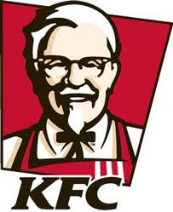
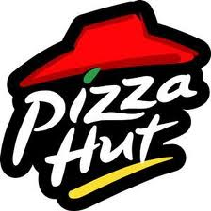

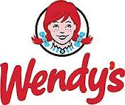
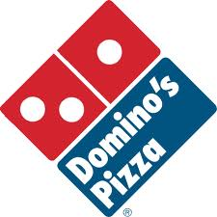
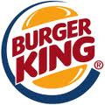
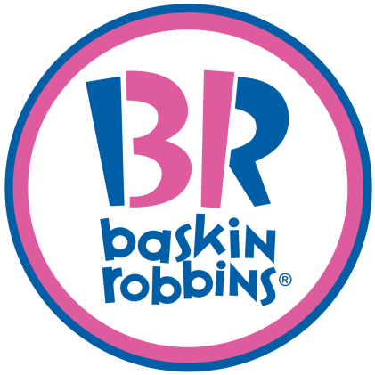
Leading Fast Food brands

Slide 37
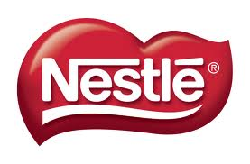
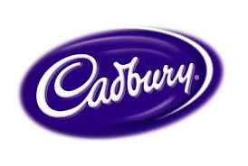
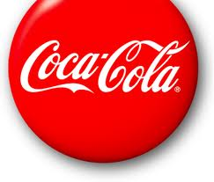
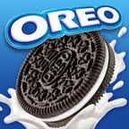
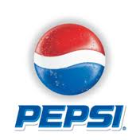
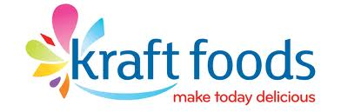
Leading Packaged Food brands

Slide 38
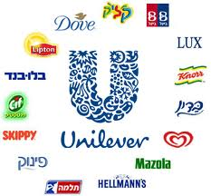
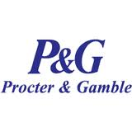

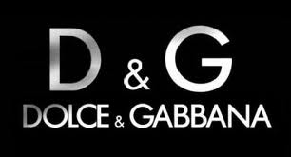
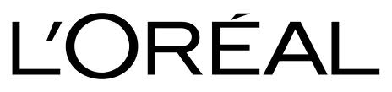
Leading Cosmetics brands

Slide 39


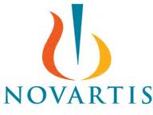
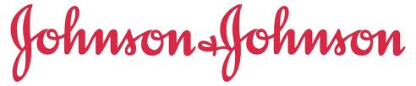

Leading Pharmaceutical brands

Slide 40
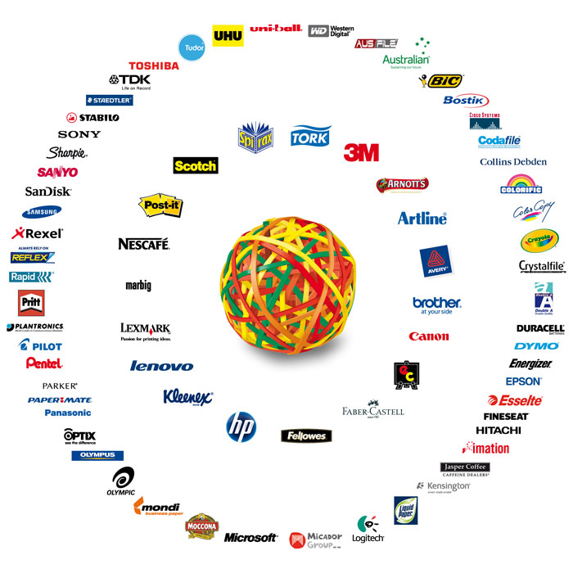
Where are the
Muslim Owned
brands ?

Slide 41

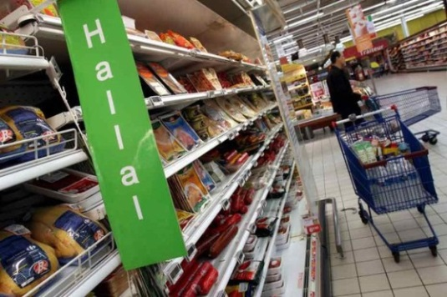
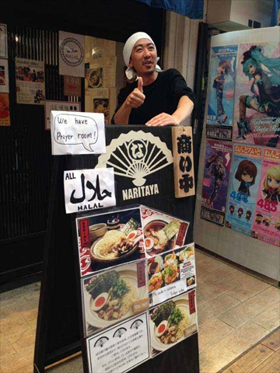
Euro Halal markets
Halal Trade has been targeting new markets in non-Muslim countries, due to the presence of Muslim tourists and large numbers of Muslim communities.
This will give greater opportunities for Islamic countries to play a major role as co-investor with offshore Halal service provider.
or to be the main origin of these products as they are more suitable to apply critical terms of Halal standards in Halal product.

Slide 42
Trade Performance: Imports of Middle East
(2009, in USD millions) Where to focus on Halal Trade?
COUNTRIES | Saudi | UAE | Turkey | Egypt | Kuwait | Qatar | Total
Live animals | 113,538 | 263,997 | 33,666 | 68,365 | 73,926 | 46,638 | 600,130
Meat & edible meat offal | 1,302,153 | 751,671 | 1,600 | 539,750 | 473,003 | 152,405 | 3,220,582
Dairy products, eggs, honey, edible animal product | 629,539 | 458,108 | 116,815 | 406,278 | 113,782 | 44,528 | 1,769,050
Products of animal origin | 7,606 | 2,617 | 28,949 | 17,615 | 515 | 279 | 57,581
Edible vegetables & certain roots, tubers | 163,677 | 438,228 | 246,078 | 306,488 | 79,274 | 48,490 | 1,282,235
Animal, vegetable fats & oils, cleavage products | 460,376 | 427,054 | 1,094,076 | 1,096,879 | 85,977 | 19,468 | 3,183,830
Meat, fish & seafood food preparation | 140,196 | 115,687 | 3,036 | 119,465 | 63,626 | 20,543 | 462,553
Miscellaneous edible preparation | 341,480 | 267,569 | 328,770 | 61,043 | 70,852 | 31,816 | 1,101,530
Essential oils, perfumes, cosmetics, toiletries | 727,097 | 1,304,134 | 839,551 | 155,801 | 127,783 | 54,401 | 3,208,767
Total | 3.8 B | 4.1 B | 2.7 B | 2.8 B | 1.1 B | 418 M | 14.9 B
Source : International Trade Centre; Trade Competitiveness Map

Slide 43
Key Factors that encourages investments in Halal Trade
2 billion by 2020
  Growth in the Muslim population, the primary market for Halal food
Affluent lifestyle
  Rising income in primary markets for Halal food
Health conscious
  Increasing demand for halal, safe, high quality food in primary markets
Diversified choices
  Increasing demand for greater variety in primary markets
Assurance & Guarantee
  Incidents of food marketed as Halal but failing to meet the Halal requirements has spurred demand for genuine Halal products (Assurance & Guarantee)
Increase awareness of religious culture in Halal
Increase in spreading Halal culture among consumers which increases the awareness of the importance of Halal requirements in Halal products, this in turn will increase the demand for Halal products.

Slide 44

Middle East Key Factors
Countries in the region are among those with:
highest per capita incomes in the world;
highest population growth rates in the world;
fastest growing middle class in the world
Net importers of processed food
    Saudi
    United Arab Emirates
    Egypt

Slide 45

Market Assessment GCC Countries
The GCC countries:
Saudi Arabia
United Arab Emirates (UAE)
Kuwait
Oman
Bahrain
Qatar

Slide 46
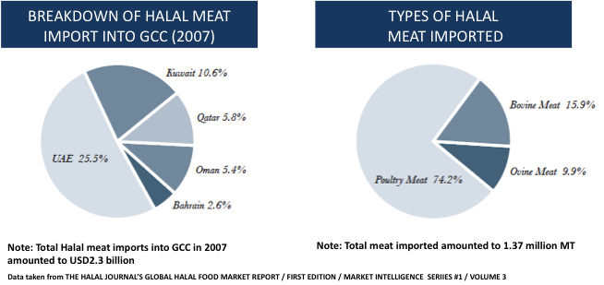
Imported of Halal meat and
meat-based products
Which meat commodity to focus on and in which country?
Breakdown of Halal meat imported into GCC (2007)
Types of Halal meat imported
UAE 25.5%
Kuwait10.6%
Beef Meats
15.9%
Qatar
5.8%
Saudi Arabia50.1%
Oman
5.4%
Mutton Meat
9.9%
Poultry Meats
74.2%
Bahrain
2.6%
Note: The estimated total halal meat imported to the GCC in 2007
B 2.3 billion USD

Slide 47
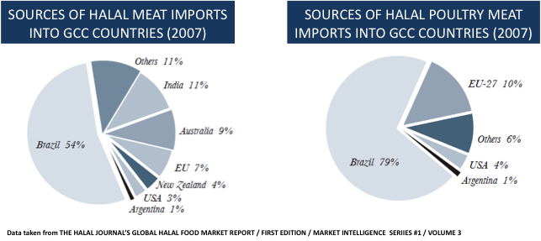
Sources of imported
Halal meat in GCC
Which exporting country to focus on?
Sources of imported Halal meat to the GCC countries (2007)
Sources of imported Halal poultry meat to GCC countries (2007)
GCC= Gulf Cooperation Council

Slide 48
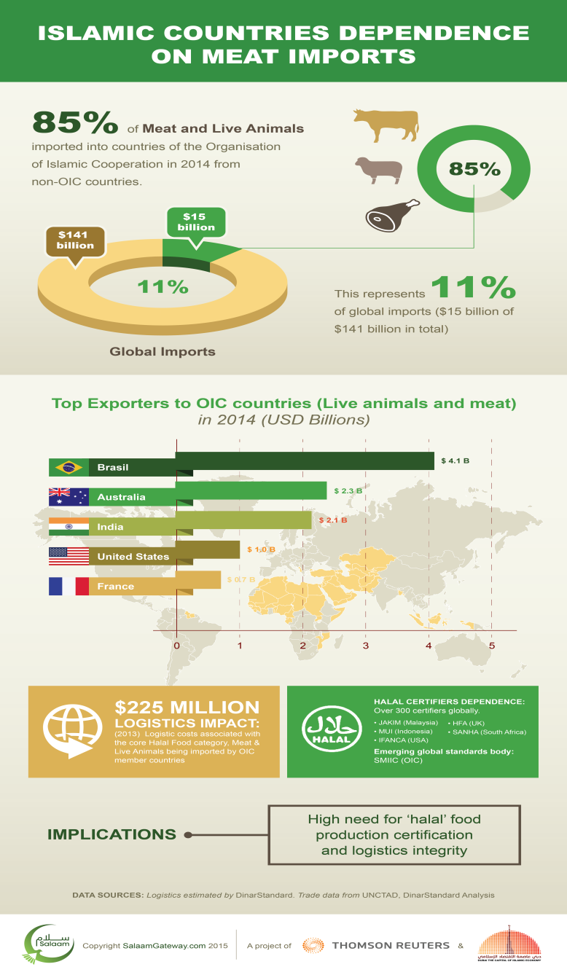
Meat Imports
Statistics
Islamic countries dependence on meat imports. https://www.salaamgateway.com/en/story/islamic_countries_dependence_on_meat_imports-SALAAM06092015165353/

Slide 49
Forecast of some segments of the Halal market
Halal Food products and beverages
Halal Pharmaceuticals, Cosmetics and Health care products
Halal Tourist/Travel
Halal hospitals
Halal modest fashion
Halal media and recreation
Halal logistics/fright
Halal laboratories
Halal Techno-economic studies
Halal training, workshops, conferences
Halal certification and auditing
Halal Traceability/HalalHaccp
Halal cleansing services
Halal R&D and Halal innovation

Slide 50
Halal Food products and beverages
Halal Food products and beverages, is the largest Halal sector within the Halal industry by expenditure and revenue and has shown clear signs of maturity with increased private equity investments in the Sector.
Upgrades in regulations are also occurring, with the introduction of accreditation to oversee certifiers set to reduce complexity and encourage more players to enter the Halal Food industry.

Slide 51
However, the sector remains fragmented, and the lack of standardized regulations has inhibited mainstream multinational food and beverage companies from entering the Halal Food industry.
Real opportunities exist for multinationals and private equity firms to acquire existing Halal Food companies and create leading global brands.
Muslim spend on food and beverage expected to reach $1.9 trillion by 2021* and $2.10 Trillion By 2025**
*STATE OF THE GLOBAL ISLAMIC ECONOMY REPORT 2016/17
https://www.salaamgateway.com/en/story/ReportStateoftheGlobalIslamicEconomy201718-SALAAM27112017104745 **https://www.grandviewresearch.com/press-release/global-halal-food-market

Slide 52
Investments opportunities in global Halal market is not limited to food sector but it also extends to other sector in the Halal industry, such as:
Halal Pharmaceuticals, Cosmetics and Health care products

Slide 53
Halal Pharmaceuticals, Cosmetics and Health care products
The Halal Pharmaceuticals, Cosmetics and Health care products sector continues to expand as awareness about ingredients rises fostering new product developments, such as permeable nail polish, the development of Halal vaccines and new ranges of Nutraceutical.
While Halal certification of pharmaceutical products is increasing, much of the certification that has occurred has been led by Muslim majority, or OIC member countries, which have well-developed Halal ecosystems, namely Malaysia and Indonesia

Slide 54
There still remains a considerable challenge in identifying Halal alternatives for common medical ingredients including gelatin, which is mostly derived from porcine.
Success of this segment of the Halal market is tied up with the increasing Halal certification activities and more mainstream players provide Halal products.
Muslim spend on pharmaceuticals and cosmetics products is expected to reach $213 billion by 2021 in aggregate

Slide 55
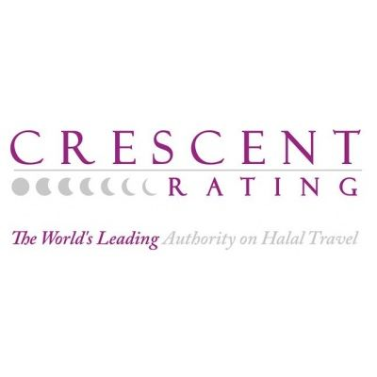
Halal Tourist/Travel
Halal Tourist/Travel, continues to broaden its reach with tremendous growth in Halal beach resorts, the launch of several dedicated airlines to the demand of Muslim consumers to Halal like Crescent Rating.

Slide 56
Halal Tourist/Travel provides Muslim-friendly services including prayer mats, direction of Kabba (Mecca) in hotel's rooms, privacy for females, Halal meals, also has Arabic-speaking employees.
While Halal Travel is a niche تخصص sector building momentum, the sector is expected to undergo rapid growth.
Muslim spend on outbound travel expected to reach $243 billion by 2021

Slide 57
Halal hospitals
There is significant scope for Halal certifiers to assess the suitability of hospital services for Muslims, including the availability of Halal Food, gender-segregated care, as well as providing training to staff on cultural and religious sensitivity topics.
Global Healthy City Chennai is India’s first Halal certified hospital.
Global Health City Chennai is a subsidiary of Global Hospitals, which is one of the fastest growing healthcare chains in India that is specializes in multi-organ transplant for liver, pancreas, kidney, heart and lungs, and provide Muslim-friendly services.

Slide 58
Halal modest fashion
Halal modest fashion is gaining mainstream interest with several retailers and brands such as a climate adapting hijab.
As the sector gains traction, spend on clothing from Muslims is projected to reach $368 billion by 2021

Slide 59
Halal media and recreation
Halal media and recreation is driving a positive reinforcement of Muslims.
Be it in publishing, new magazines or new offerings such as Muslim Kids TV and notable technological innovations such as Quran Academy.
Muslim spend media and recreation
is expected to reach $262 billion by 2021

Slide 60
Halal logistics/fright
Halal logistics/fright is a multi million dollar business. Germany’s busiest airport considering halal air cargo.
Being of a Halal nature this activity can only be taken by Halal certification bodies.
At present, this service is provided as part of Halal certification services.
This service can be also provided as a separate service by a specialized Halal logistics/fright certification body.
No information is available on the value of this segment of the Halal market

Slide 61
Halal laboratories
Halal laboratories are important to provide necessary technical supports to strengthen Halal certification Services.
It is impossible to issue an honest Halal certificate for any Halal product or a Halal service without a certificate from laboratory analysis from a Halal and Quality Laboratory.
Halal laboratories certified as Halal ISO 17025 are rarely found on the globe.
No information is available on the value of this segment of the Halal market

Slide 62
Halal Techno-economic studies
Halal Techno-economic studies provided by feasibility studies company service provider is a rare service as well, this is due to the lack of sound statistics on the Halal market.
No information is available on the value of this segment of the Halal market

Slide 63
Halal training, workshops, conferences
Halal training, workshops, conferences is a very active Halal market.
Halal awareness can be achieve by Halal training, workshops, conferences as well as statistical routine survey study of Halal awareness of any population.
Media can be use to drive a population to understand Halal.
No information is available on the value of this segment of the Halal market

Slide 64
Halal certification and auditing
Halal certifications and auditing is bedrock and the backbone of the entire Halal economy.
Their are over 300 Halal certification bodies around the world, with no one Halal standard that unite them and five main Halal accreditation bodies namely:
    SMIIC (OIC)
    ESMA (Dubai)
    GAC (GSO/GCC)
    HDC Jakim (Malaysia)
    MOI (Indonesia)

Slide 65
Chaos in Halal standards will put Muslim consumers in doubts
Pakistan follow the SMIIC standards;
Indonesia have its own standards;
Malaysia have its own system and studies now ESMA standards to accredit;
Turkey, as a country, has no halal standards implemented by the government. Gimdes, a HCB in Turkey has its own rules.
The Gulf States are using the GAC rules, while on the other hand the Emirates still keep the ESMA standards.
No information is available on the value of this segment of the Halal market

Slide 66
Halal certification bodies
Current scenario
Number of Halal Certification Bodies by Region
Over 300 Halal CBs in operation, however only 33% are registered legal bodies

Slide 67
Recognized Halal certification bodies (HCBs) in GCC countries
South America
12%
Australia / Oceania
17%
North America
12%
Asia
19%
Africa
12%
Europe
28%s
Total No of HCBs recognized : 52

Slide 68
Lack of mutual recognition
GCC COUNTRIES
52
23
16
14
MALAYSIA
50
25
INDONESIA 33

Slide 69
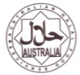



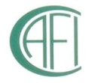

List of HCBs recognized by Malaysia, Indonesia and GCC
No
Country
HCB
Logo
1
Australia
Australian Halal Food Services (AHFS)
2
Australia
Adelaide Mosque Islamic Society of South Australia
3
Australia
Islamic Association of Katanning Inc.
25
4
Australia
Islamic Co-ordinating Council of Victoria (ICCV)
5
Australia
The Australian Federation of Islamic Councils (AFIC)
6
Australia
The Perth Mosque of Western Australia Inc
7
Netherlands
Control Office of Halal Slaughtering & Halal Quality Control

Slide 70

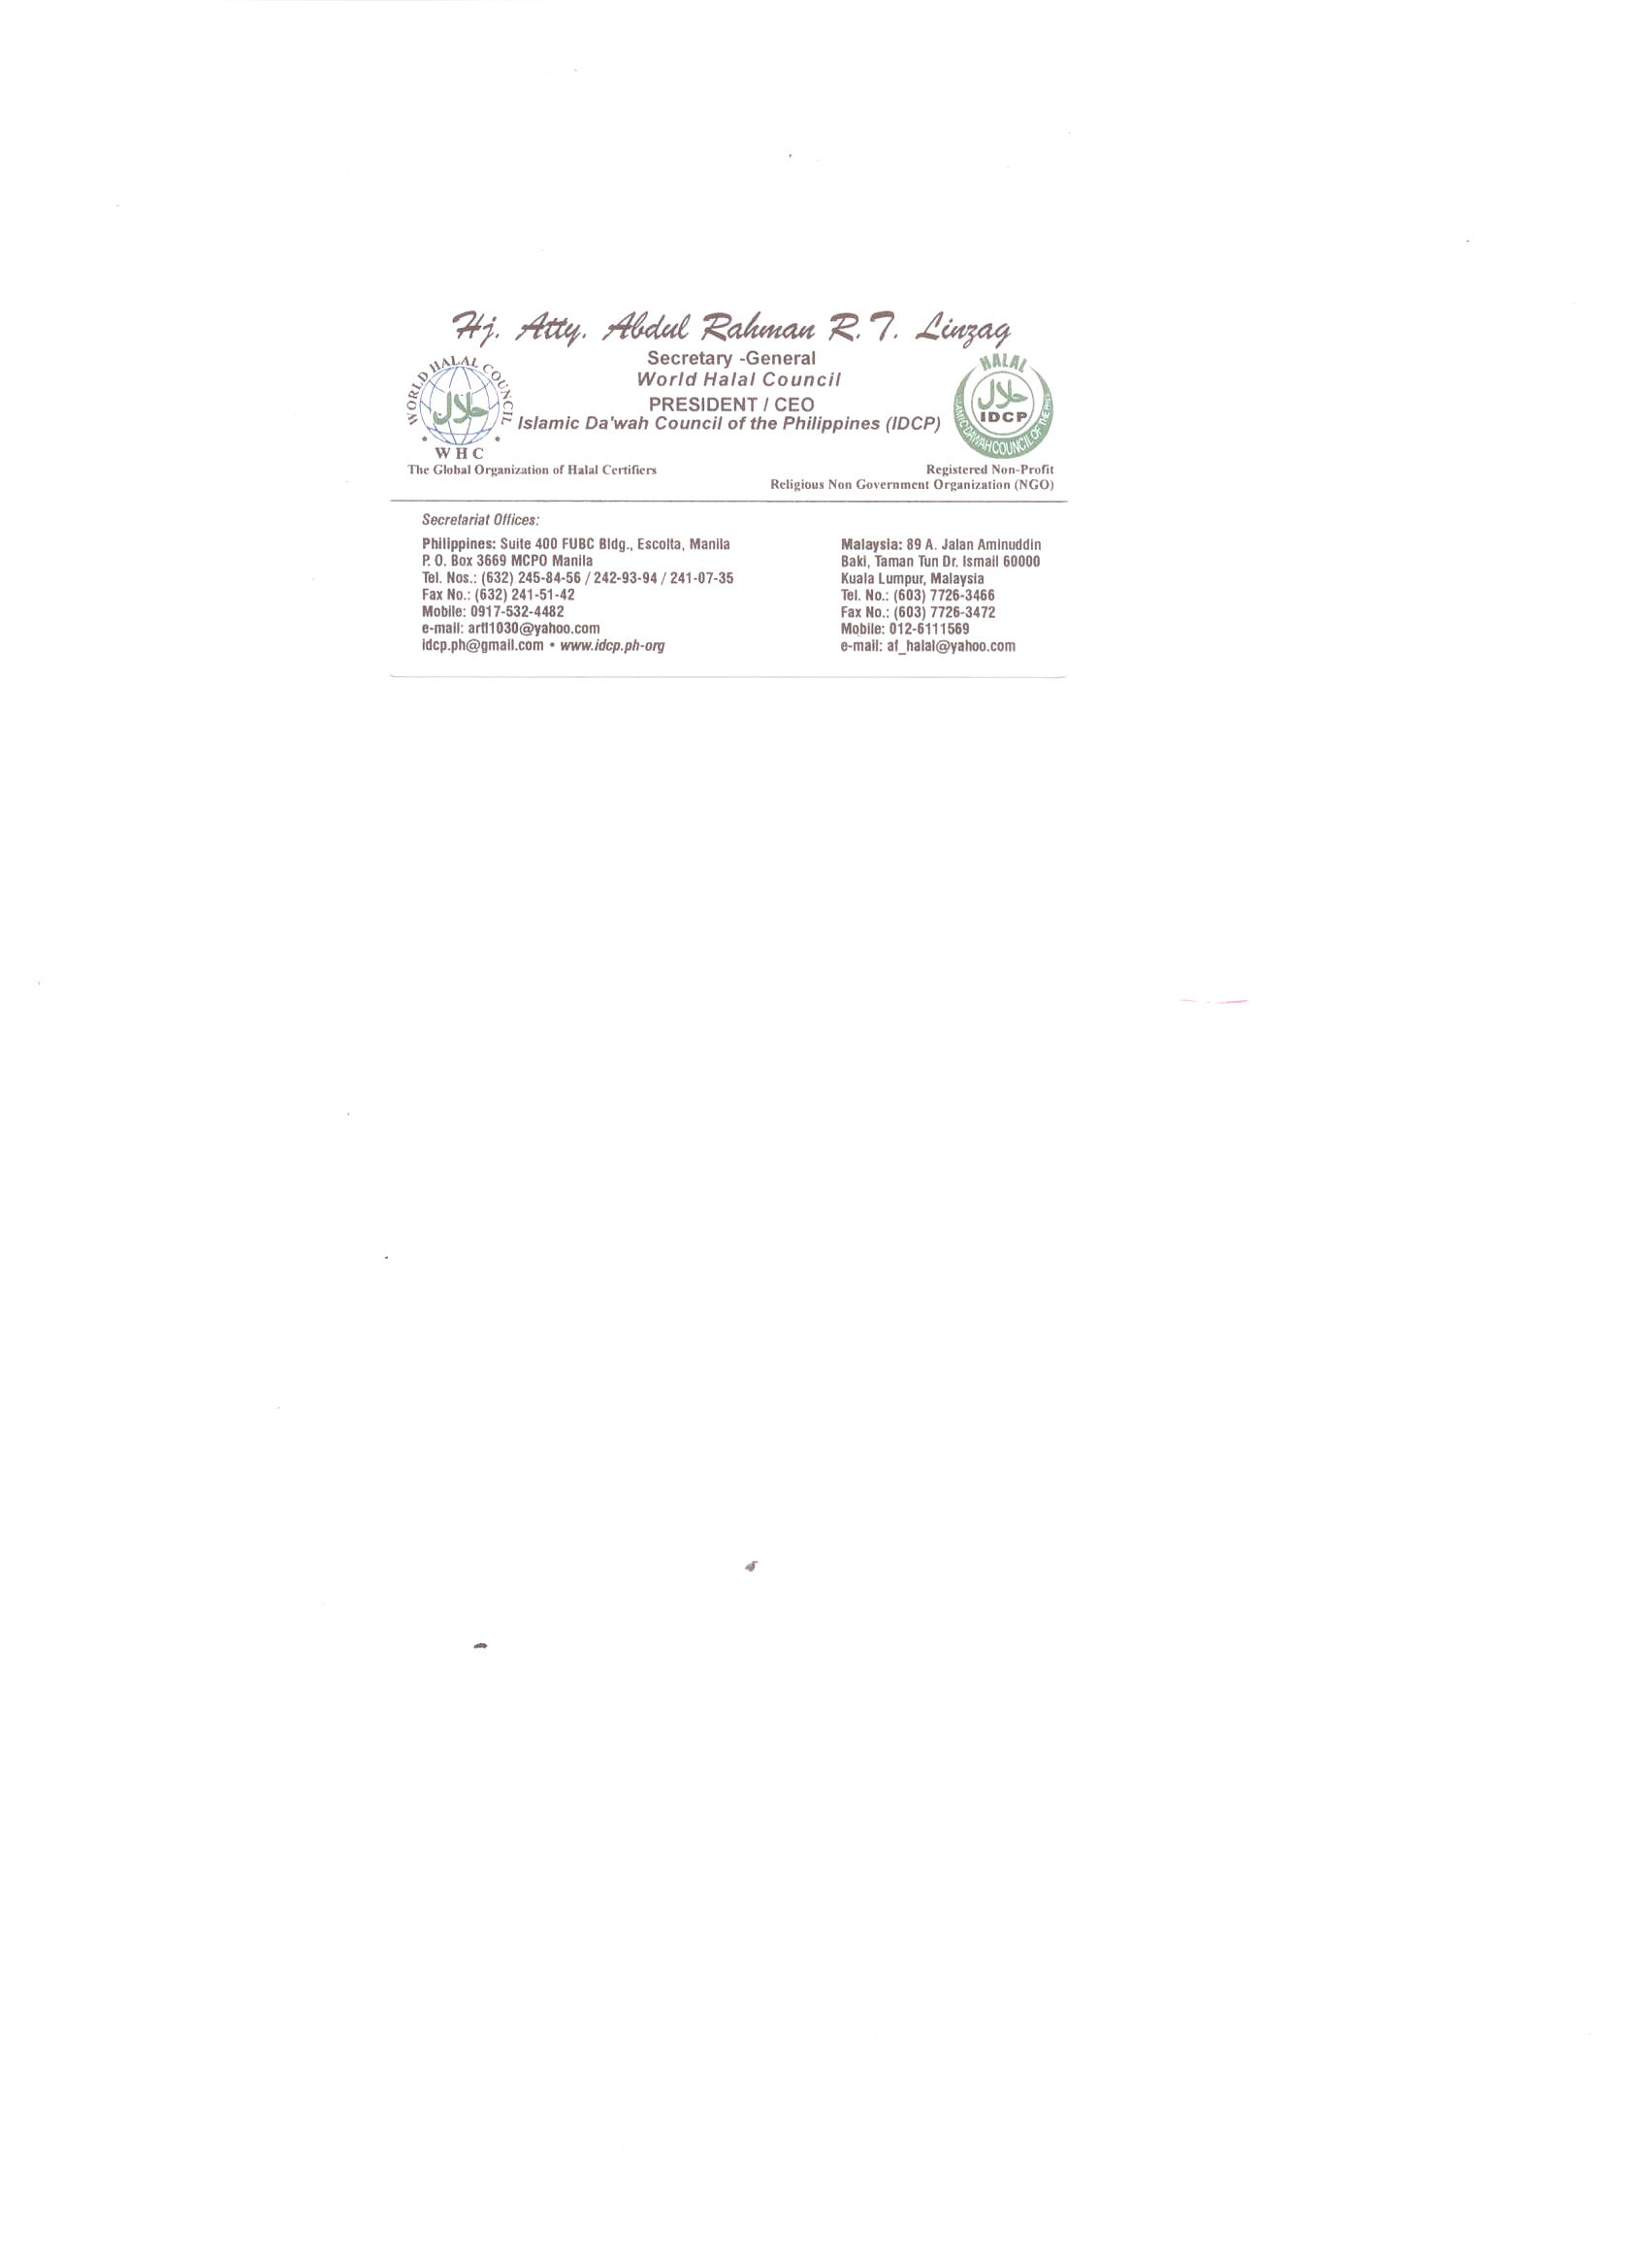
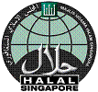




No
Country
HCB
Logo
8
New Zealand
Federation of Islamic Associations of New Zealand (FIANZ)
9
Philippines
Islamic Da’wah Council of the Philippines (IDCP)
10
Singapore
Islamic Religious Council of Singapore (MUIS)
11
South Africa
South African National Halaal Authority (SANHA)
12
Thailand
The Central Islamic Committee of Thailand (CICOT)
13
USA/Canada
Islamic Food and Nutritional Council of America (IFANCA)
14
USA
Islamic Services of America (ISA)
Halal certification bodies in non-Muslim countries are important because they provide valuable information from day to day on Halal, Haram and the doubts in products & services to warn Muslims worldwide. In addition, HCBs act as a working tools in the field of Halal consultancies.

Slide 71
Halal Traceability/HalalHaccp
Halal Traceability/HalalHaccp by themselves are services that a Halal certification body can provide to the Halal industry. HFFIA of the Netherland specialized in such services.
Halal Traceability trace the origin of Halal raw material throughout its chain to assure its Halalness. In addition, the HalalHaccp service which is a food safety service that insure that the Halal food which is under certification meets the ISO22000 international food safety standard.
No information is available on the value of this segment of the Halal market

Slide 72
Halal cleansing services
Halal cleansing services is another service that can be provided by a Halal certification body. Halal Control of Germany is specialized of such services.
Halal cleansing services switch the non-Halal processing lines to Halal processing lines.
No information is available on the value of this segment of the Halal market

Slide 73
Halal R&D and Halal innovation
Halal R&D and Halal innovation will encourage the search for new Halal raw materials, Halal testing analyses, and new markets to increase profits.
No information is available on the value of this segment of the Halal market

Slide 74

Trade Issues
The Halal market is huge and is global
But Halal is interpreted differently in different countries
Lack of mutual recognition on trade matters among OIC country members
Lack of competent Halal Certification Bodies
Lack of common Halal standards
OIC = Organization of Islamic Cooperation

Slide 75
6. In almost all countries, Halal is a religious issue. Hence, the state government such as GCC is just beginning to intervene
7. Normally, Halal is regulated under the labeling law
8. Halal certification, therefore, is conducted by many agencies/ associations/ councils/ federations, etc
9. Most traded Halal products are imported from non-OIC countries
10. The OIC is a net importer of Halal food

Slide 76

What to Focus?
Have your Halal Certification Body accredited by Halal accreditation bodies (GAC, ESMA, MUI, JAKIM, IHAF, etc.)
Collaborate with accredited HCB that provide true Halal.
Adopt true Halal Standard.
Must review your Halal Import Control:
  Policies and Regulations
  Import Data base
  Automated food import management system – clearance, hold, analysis or rejection
  Screening tools: rapid test kit, analytical support

Slide 77
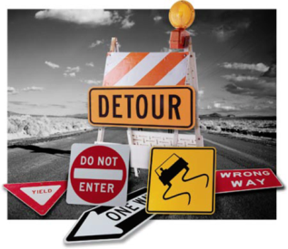
Barriers to Halal trade
Of the most prominent barriers to Halal trade that emerged during the last thirty years are the following:
Lack of consumer awareness of the concept of Halal products which is due to the ambiguity of information about the origin of the components of the raw materials used in the Halal products.
Lack of Halal feasibility studies. How to enter the trillion $$ market?

Slide 78
2. Most of the governments of the Islamic countries and consumers are not serious about Halal products and its services and their authenticities (Mafee Mushkila = Kullu Halal).

Slide 79

The chances of Haram contamination in non-Halal certified products as Halal is not limited to meat only, and
The danger of self declaration (Kullu Halal): writing “Halal” is self declaration.
This can be avoided if products are certified Halal.
Many examples of Haram products labeled as Halal, by mistake or falsely labeled, but the reason is One: Self Declaration.

Slide 80
3. In addition, non-Muslim establishments are ignorance of what is Halal and what is Haram and how to go about it.
This has lead to the most important obstacle, that is the refusal of some non-Muslim countries Halal certification specifically by Islamic centers and turn it into a political issue.

Slide 81
4. Finally, muftis not in agreeable ground on what is Halal and what is Haram with emergent issues such as:
    Stunning
    Mechanical slaughtering
    Use of alcohol
    Use of E120 and other food additives
    Istihala of certain Najis materials such as: Gelatin, Plasma, fat, alcohol, etc.
    Slaughter of Ahlulkitab

Slide 82
Solving Halal trade
Halal certification as an effective solution
Halal Certification is a MUST to declare products as Halal.
Guarantee of Quality, Hygiene, Safety & Shariah compliance.
Enhances consumer confidence.
Certified Halal means Authentic Halal.

Slide 83
Brand Halal
Halal has now become an International Brand.
A brand label globally recognized among Muslims & non Muslims for
‘Good Quality & Healthy products’
expanding the Halal Certified trade to almost $3 trillion, a year..

Slide 84
Halal R&D
It could be of benefit to collaborate with international R&D laboratories, training and scientific research centers to provide necessary training and prepare indicators on Halal analysis, Halal trade supported by techno-economic studies.

Slide 85
Mutual collaboration
We note here on the importance of the efforts that must be made ​​by government regulators¹, chambers of commerce², scientific research centers³, universities⁴, scientific applied colleges⁵, and official religious bodies⁶ in promoting and expanding the role of the private sector in the Halal trade.

Slide 86
Halal has Gone Mainstream
Halal logo has now become a symbol of quality and religious compliance and this makes it sound as the new green.
McDonald’s in Singapore has seen an influx of eight million patrons a year after obtaining a Halal certification.
Since being certified Halal, KFC, Burger King and Taco Bell have all seen an increase of 20 per cent in customers
Halal has also been extended to downstream products and services such as laboratory, cosmetics and pharmaceuticals, hygiene products and nutritional supplements, travel, art, music and books; even marriage and finance.

Slide 87
Proposed Collaboration
For the growth of capital and to provide jobs opportunities
Supports from
Islamic Development Bank, IDB
Support from
investors and
financial companies
Provide feasibility
studies on Halal
projects
Halal
Products
& Services
Official facilities
from government
Financial facilities
from government

Slide 88
Summary
The Halal market encompass a wide range of a diverse spectrum of products and services, including:
Food products and beverages
Pharmaceuticals, Cosmetics and Health care products
Tourist/travel, fashion, media and recreation
Personal and household detergents
Primary raw materials
Supportive Halal services
*STATE OF THE GLOBAL ISLAMIC ECONOMY REPORT 2016/17
https://www.salaamgateway.com/en/story/ReportStateoftheGlobalIslamicEconomy201718-SALAAM27112017104745/

Slide 89
Food products and beverages including:
Meat and meat products
Milk and dairy products
Cereal and Cereal products
Enzymes, Micro-organisms and Genetically Modified Food
Food additives
Beverages
Sugar and confectionery products
Dietary supplements
Packaging
Food service and premise

Slide 90
Investments opportunities in global Halal market is not limited to food sector but it also extends to other sector in the Halal industry, such as:
Body builders & healthcare products
Personal cleaning products
Primary raw materials
Tourist/travel, fashion, media and recreation
Supportive Halal services

Slide 91
Body builders & healthcare products like:
vitamins
proteins
Whey
Personal cleaning products like:
Soap bars
Liquid soap
Tooth pastes
Shampoos
Washing detergents

Slide 92
Primary raw materials like:
Fats for soap making etc.,
Fatty acids, amino acids, proteins, etc.,
Enzymes such as rennet
Gelatin
Salts
Investment in Halal raw materials such as glycerin, gelatin, salts and enzymes is considered as one of the successful investment area in Halal as it provides the raw materials for many Halal products. Halal Laboratory can play a major role in the authentication of Halal raw materials.

Slide 93


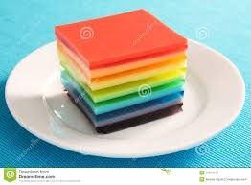
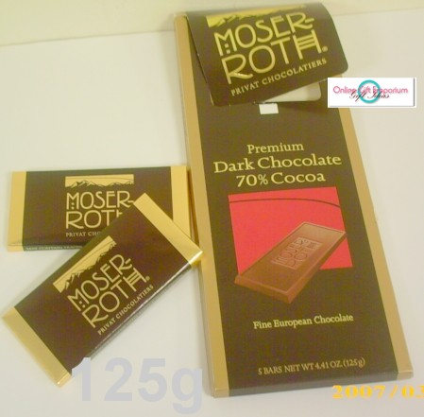
Example of Halal raw material is Gelatin, it is used in:
Food
Flavored milk
Yogurt
Sour cream
Cottage cheese
Imitation dairy products
Ice cream
Cheesecakes
Marshmallow
Confectionery
Chocolates
Jellied beef
Corned beef
Fruit juices
Cereals
Puddings etc.
Pharmaceuticals
Cosmetics
Halal analysis is required to authenticate the origin of raw material

Slide 94
Tourist/travel, fashion, media and recreation like:
Halal Tourist/travel
Halal hospitals
Halal modest fashion
Halal media and recreation

Slide 95
Supportive Halal services like:
Halal logistics/fright
Halal Laboratories
Halal Techno-economic studies
Halal training, workshops, conferences
Halal certification and auditing
Halal traceability/HalalHaccp
Halal cleansing services
,,
Halal R&D and Halal innovation

Slide 96
Conclusions
Muslim courtiers, with its expanding production base has great potential to export Halal products to the non-Muslim world.
Growth of Halal products beyond food suggest significant growth opportunities in all sectors, specially Pharmaceuticals, Cosmetics & Skin care for Muslim courtiers.
Halal Tourism industry is booming in the world and Muslim courtiers has great potential to take advantage from it.
Research highlights that Success can be achieved through a mix of Quality, Branding and Halal Authentication to penetrate the Halal market.

Slide 97
Recommendation
Estimate figures on the size of the Halal market in total and its segments are not consistent in published works, this mean that there is a need to have studies on the correct figures on the size of this market in its segments.

Slide 98
References
Potential & Opportunities in Halal Industry - An Overview by Asad Sajjad, CEO of Gulf Halal Center Prepared for World Halal Assembly OMAN, 2017, Organized by Al-Nimr Expo & HDCMICE middle east, May 16th - 17, 2017
The competitiveness of halal food industry in Malaysia: A SWOT - ICT analysis: GEOGRAFIA OnlineTM Malaysia Journal of Society and Space 9 issue 1 (1 - 9) 1 ©2013, ISSN 2180-2491 The competitiveness of halal food industry in Malaysia: A SWOT - ICT analysis: GEOGRAFIA OnlineTM Malaysia Journal of Society and Space 9 issue 1 (1 - 9) 1 ©2013, ISSN 2180-2491http://www.ukm.my/geografia/images/upload/1.geografia-jan%202013-manaf-edam%20%281-9%291.pdf
Dubai chamber of commerce (2013). http://www.dubaichamber.com/whats-happening/chamber_news/dubai-chamber-report-shows-increasing-preference-for-halal-food-as-global-market-grows-to-us1-1-trillion-in-2013
STATE OF THE GLOBAL ISLAMIC ECONOMY REPORT 2016/17
https://www.salaamgateway.com/en/story/ReportStateoftheGlobalIslamicEconomy201718-SALAAM27112017104745/
Islamic countries dependence on meat imports.
Halal Industry : Key Challenges and Opportunities (2016), Hussein Elasrag, Munich Personal RePEc Archive. https://mpra.ub.uni-muenchen.de/69631/1/MPRA_paper_69631.pdf
Zakaria, Z. (2008). "Tapping into the world halal market: some discussions on Malaysian laws and standards." Shariah Journal 16(3): 603-616.
https://www.grandviewresearch.com/press-release/global-halal-food-market
https://www.salaamgateway.com/en/story/islamic_countries_dependence_on_meat_imports-SALAAM06092015165353/
http://www.alriyadh.com/962000
http://www.alriyadh.com/960466
http://azkahalal.files.wordpress.com/2013/02/arabic_version_of_halal_culture_presentation_2013.pdf
http://azkahalal.files.wordpress.com/2012/06/gimdes-2012_dr-hani-al-mazeedi1.pdf
http://www.asidcom.org/IMG/pdf/L20-_Hani_M-_Al-Mazeedi_Arabic_English_2.pdf
http://www.asidcom.org/IMG/pdf/L1-_Darhim_Dali_Hashsim.pdf
http://www.asidcom.org/IMG/pdf/L26-_Dr-_Irfan_Sungkar.pdf
http://azkahalal.files.wordpress.com/2014/05/kisr-halal-2014-mariam-abdulatif.pdf

Slide 99
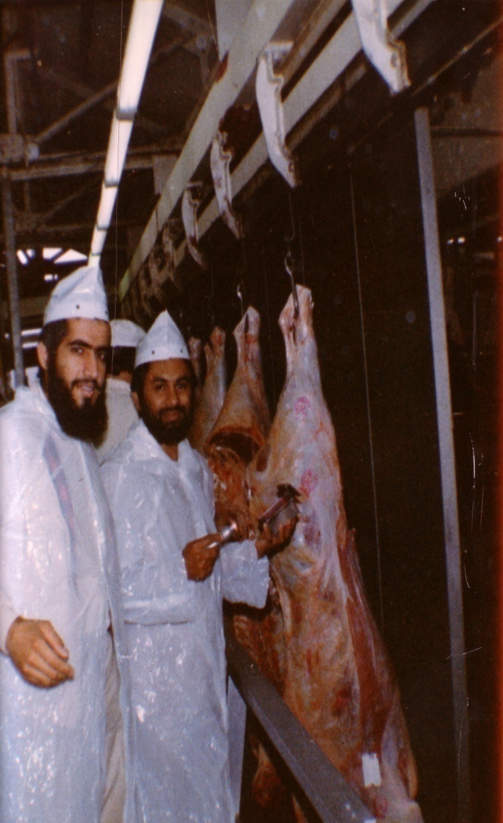
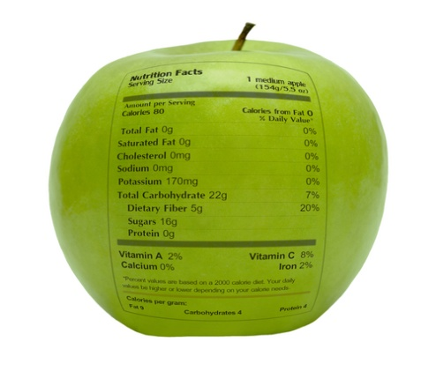
شكراً لاستماعكم
سبحنك اللهم وبحمدك أشهد أن لا إله إلا أنت، أستغفرك وأتوب إليك
د. هاني منصور المزيدي
مع الأخ أمجد محبوب في أستراليا سنة 1981
Dr. Hani Mansour Al-Mazeedi
With brother Amjad Mahboob in Australia in 1981

Slide 100

www.HalalEA.com
Trademarks, icons, images belong to their respective owners.
© Halal Sciences Academy Limited

